Slide 1



chapter 4
the interaction

Slide 2
The Interaction
interaction models
  translations between user and system
ergonomics
  physical characteristics of interaction
interaction styles
  the nature of user/system dialog

Slide 3
What is interaction?
Interaction: it is a communication between the user and the system.
user  system

Slide 4
models of interaction
terms of interaction
Norman model
interaction framework

Slide 5
models of interaction(cont…)
Models to help us to understand complex behavior and complex systems
Interaction involves at least two participants: the user and the system.
Both are complex, as we have seen, and are very different from each other in the way that they communicate and view the domain and the task.

Slide 6
models of interaction(Cont…)
The interface must therefore effectively translate between them to allow the interaction to be successful.
The use of models of interaction can help us to understand exactly what is going on in the interaction and identify the likely root of difﬁculties.
They also provide us with a framework to compare different interaction styles and to consider interaction problems.

Slide 7
Some terms of interaction
The purpose of an interactive system is to aid a user in accomplishing goals from some application domain.
Domain – the area of work under study
  e.g. graphic design
goal – what you want to achieve
  e.g. create a solid red triangle
tasks – are operations to manipulate the concepts of a domain.
– ultimately in terms of operations or actions
  e.g. … select fill tool, click over triangle

Slide 8
Donald Norman’s model
It also known as The execution–evaluation cycle.
The interactive cycle can be divided into two major phases: execution and evaluation.
These can then be subdivided into further stages, seven in all.

Slide 9
Seven stages
  user establishes the goal
  formulates intention
  specifies actions at interface
  executes action
  perceives system state
  interprets system state
  evaluates system state with respect to goal
Norman’s model concentrates on user’s view of the interface

Slide 10
execution/evaluation loop
goal
    user establishes the goal
    formulates intention
    specifies actions at interface
    executes action
    perceives system state
    interprets system state
    evaluates system state with respect to goal
execution
evaluation
system

Slide 11
execution/evaluation loop
goal
    user establishes the goal
    formulates intention
    specifies actions at interface
    executes action
    perceives system state
    interprets system state
    evaluates system state with respect to goal
execution
evaluation
system

Slide 12
execution/evaluation loop
goal
    user establishes the goal
    formulates intention
    specifies actions at interface
    executes action
    perceives system state
    interprets system state
    evaluates system state with respect to goal
execution
evaluation
system

Slide 13
execution/evaluation loop
goal
    user establishes the goal
    formulates intention
    specifies actions at interface
    executes action
    perceives system state
    interprets system state
    evaluates system state with respect to goal
execution
evaluation
system

Slide 14
Using Norman’s model
Norman uses this model of interaction to demonstrate why some interfaces cause problems to their users.
He describes these in terms of the gulfs of execution and the gulfs of evaluation.
The gulf of execution is the difference between the user’s formulation of the actions to reach the goal and the actions allowed by the system.

Slide 15
Using Norman’s model
If the actions allowed by the system correspond to those intended by the user, the interaction will be effective.
The interface should therefore aim to reduce this gulf.
The gulf of evaluation is the distance between the physical presentation of the system state and the expectation of the user.

Slide 16
Using Norman’s model
If the user can readily evaluate the presentation in terms of his goal, the gulf of evaluation is small.
The more effort that is required on the part of the user to interpret the presentation, the less effective the interaction.

Slide 17
Using Norman’s model
Some systems are harder to use than others
Gulf of Execution
  user’s formulation of actions
  ≠ actions allowed by the system
Gulf of Evaluation
  user’s expectation of changed system state
  ≠ actual presentation of this state

Slide 18
Human error - slips and mistakes
Human errors are often classiﬁed into slips and mistakes. We can distinguish these using Norman’s gulf of execution.
If you understand a system well you may know exactly what to do to satisfy your goals.
You have formulated the right action, but fail to execute that action correctly.
This is called Slips.

Slide 19
Human error - slips and mistakes
if you don’t know the system well you may not even formulate the right goal. This is called a mistake.
If we discover that an interface is leading to slips or mistakes.
Slips may be corrected by, for instance, better screen design, perhaps putting more space between buttons.
Mistakes need users to have a better understanding of the systems, so will require redesign or improved training.

Slide 20

Human error - slips and mistakes
slip
  understand system and goal
  correct formulation of action
  incorrect action
mistake
  may not even have right goal!
Fixing things?
slip – better interface design
mistake – better understanding of system

Slide 21
Abowd and Beale framework
extension of Norman…
their interaction framework has 4 parts
  user
  input
  system
  output
each has its own unique language
interaction ⇒ translation between languages
O
output
S
core
U
task
I
input

Slide 22
ergonomics
physical aspects of interfaces
industrial interfaces

Slide 23
Ergonomics
Study of the physical characteristics of interaction
Also known as human factors – but this can also be used to mean much of HCI!
Ergonomics good at defining standards and guidelines for constraining the way we design certain aspects of systems

Slide 24
Ergonomics
Issues and problems addressed by ergonomics
arrangement of controls and displays
  e.g. controls grouped according to function or frequency of use, or sequentially
surrounding environment
  e.g. seating arrangements adaptable to cope with all sizes of user
health issues
  e.g. physical position, environmental conditions (temperature, humidity), lighting, noise,
use of colour
  e.g. use of red for warning, green for okay,
  awareness of colour-blindness etc.

Slide 25
interaction styles

Slide 26
Common interaction styles
command line interface
menus
natural language
question/answer and query dialogue
form-fills and spreadsheets
WIMP
point and click
three–dimensional interfaces

Slide 27
Command line interface
Way of expressing instructions to the computer directly
  function keys, single characters, short abbreviations, whole words, or a combination
suitable for repetitive tasks
better for expert users than novices
offers direct access to system functionality
command names/abbreviations should be meaningful!
Typical example: the Unix system

Slide 28
Menus
Set of options displayed on the screen
Options visible
  less recall - easier to use
Selection by:
  numbers, letters, arrow keys, mouse
  combination (e.g. mouse plus accelerators)
Often options hierarchically grouped
  sensible grouping is needed
Restricted form of full WIMP system

Slide 29
Natural language
Familiar to user
speech recognition or typed natural language
Problems
  vague
  ambiguous
  hard to do well!
Solutions
  try to understand a subset
  pick on key words

Slide 30
Query interfaces
Question/answer interfaces
  user led through interaction via series of questions
  suitable for novice users but restricted functionality
  often used in information systems
Query languages (e.g. SQL)
  used to retrieve information from database
  requires understanding of database structure and language syntax, hence requires some expertise

Slide 31
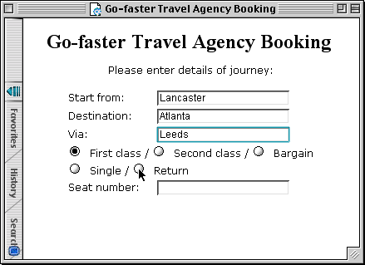
Form-fills
Primarily for data entry or data retrieval
Screen like paper form.
Data put in relevant place
Requires
  good design
  obvious correction
  facilities

Slide 32
Spreadsheets
MS Excel most common today
sophisticated variation of form-filling.
  grid of cells contain a value or a formula
  formula can involve values of other cells
  e.g. sum of all cells in this column
  user can enter and alter data spreadsheet maintains consistency

Slide 33
WIMP Interface
Windows
Icons
Menus
Pointers
default style for majority of interactive computer systems, especially PCs and desktop machines

Slide 34
Point and click interfaces
used in ..
  multimedia
  web browsers
  hypertext
just click something!
  icons, text links or location on map
minimal typing

Slide 35


Three dimensional interfaces
virtual reality
‘ordinary’ window systems
  highlighting
  visual affordance
  indiscriminate use
  just confusing!
3D workspaces
  use for extra virtual space
  light and occlusion give depth
  distance effects
flat buttons …
click me!
… or sculptured

Slide 36
elements of the wimp interface
windows, icons, menus, pointers
also see supplementary material
on choosing wimp elements

Slide 37
Windows
Areas of the screen that behave as if they were independent
  can contain text or graphics
  can be moved or resized
  can overlap and obscure each other, or can be laid out next to one another (tiled)
scrollbars
  allow the user to move the contents of the window up and down or from side to side
title bars
  describe the name of the window

Slide 38
Icons
small picture or image
represents some object in the interface
  often a window or action
windows can be closed down
  small representation many accessible windows
icons can be many and various
  highly stylized
  realistic representations.

Slide 39
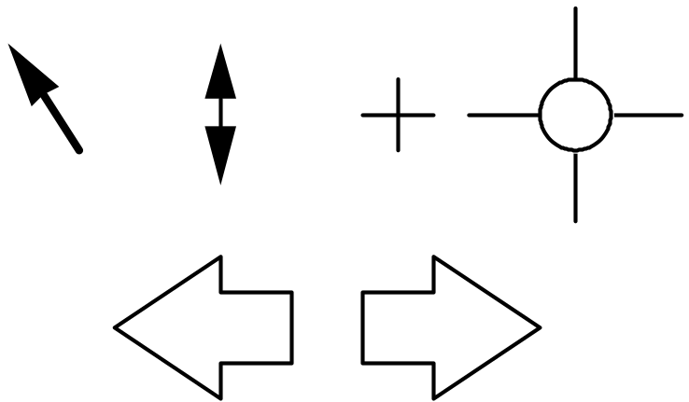
Pointers
important component
  WIMP style relies on pointing and selecting things
uses mouse, trackpad, joystick, trackball, cursor keys or keyboard shortcuts
wide variety of graphical images

Slide 40
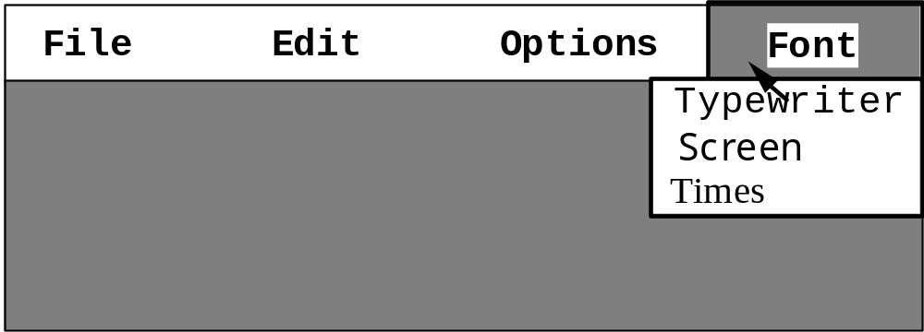
Menus
Choice of operations or services offered on the screen
Required option selected with pointer
problem – take a lot of screen space
solution – pop-up: menu appears when needed

Slide 41
Menus design issues
which kind to use
what to include in menus at all
words to use (action or description)
how to group items
choice of keyboard accelerators

Slide 42
Question??
Thanks

